Slide 1
Ups system & batteries and Electrical switch gear
Prepared by :1) Anusha G S
2) Kousik Garai
3) Manoj Kushwaha

Slide 2
WHAT IS UPS?
An Uninterruptible Power Supply (UPS) is defined as a piece of electrical equipment which can be used as an immediate power source to the connected load when there is a failure in the main input power source.
Types of UPS:-
1)Off-line ups
2)On-line ups
3)Line interactive ups

Slide 3
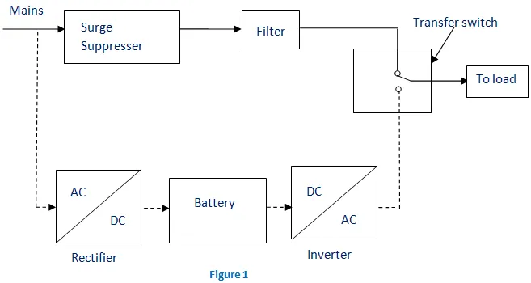
Off- line UPS

Slide 4
Off-line ups
This UPS is also called as Standby UPS system which can give only the most basic features. Here, the primary source is the filtered AC mains (shown in solid path in figure 1).
When the power breakage occurs, the transfer switch will select the backup source (shown in dashed path in figure 1).
Thus we can clearly see that the stand by system will start working only when there is any failure in mains. In this system, the AC voltage is first rectified and stored in the storage battery connected to the rectifier.
When power breakage occurs, this DC voltage is converted to AC voltage by means of a power inverter, and is transferred to the load connected to it.
This is the least expensive UPS system and it provides surge protection in addition to back up. The transfer time can be about 25 milliseconds which can be related to the time taken by the UPS system to detect the utility voltage that is lost. The block diagram is shown below.

Slide 5
On-line UPS
In this type of UPS, double conversion method is used. Here, first the AC input is converted into DC by rectifying process for storing it in the rechargeable battery.
This DC is converted into AC by the process of inversion and given to the load or equipment which it is connected (figure 2).
This type of UPS is used where electrical isolation is mandatory. This system is a bit more costly due to the design of constantly running converters and cooling systems.
Here, the rectifier which is powered with the normal AC current is directly driving the inverter. Hence it is also known as Double conversion UPS. The block diagram is shown below

Slide 6
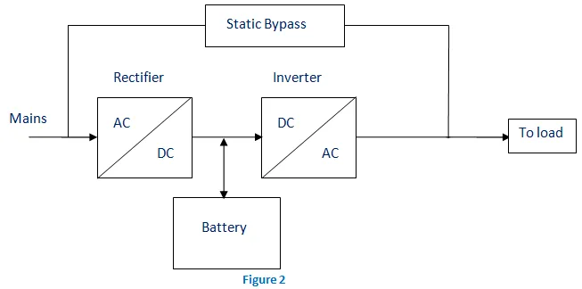
On-line ups

Slide 7
On-line UPS
When there is any power failure, the rectifier have no role in the circuit and the steady power stored in the batteries which is connected to the inverter is given to the load by means of transfer switch.
Once the power is restored, the rectifier begins to charge the batteries. To prevent the batteries from overheating due to the high power rectifier, the charging current is limited. During a main power breakdown, this UPS system operates with zero transfer time.

Slide 8
Line Interactive UPS
For small business and departmental servers and webs, line interactive UPS is used. This is more or less same as that of off-line UPS.
The difference is the addition of tap changing transformer. Voltage regulation is done by this tap-changing transformer by changing the tap depending on input voltage. Additional filtering is provided in this UPS result in lower transient loss. The block diagram is shown below.
The reason is that the backup source acts as a primary source and not the main AC input. But the presence of inrush current and large load step current can result in a transfer time of about 4-6 milliseconds in this system.

Slide 9
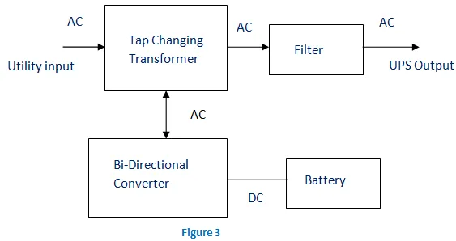
Line interactive system

Slide 10
Batteries &it’s types
Batteries: A battery is a device that stores chemical energy and converts it to electrical energy.
Types:
Lead-Acid UPS Batteries :
Lead-Acid batteries have a proven track record for reliability when used in an uninterruptible power supply system.
In large power applications, where weight isn’t the overriding concern, they provide the most economical choice.This cost-effectiveness is combined with other performance qualities such as low internal impedance and high tolerance.
Lead-Acid batteries come in two different types:

Slide 11
Value Regulated(VRLA)
Also known as Sealed Lead-Acid (SLA), this is the most common type found in modern UPS systems. They typically come with a 5 or 10-year design life and are best stored in a dry, climate-controlled room at a temperature of 20-25°C.
VRLA batteries are sealed inside a case which has a valve that vents to release gas if internal pressure gets too much, hence the term “valve regulated”.
Because they are sealed, they can be mounted either vertically or horizontally, so are suitable for use within battery compartments, rackmount trays or external cabinets. In addition, they don’t need any direct maintenance such as being regularly topped up with water.
There are two main types of electrolyte composition used in a VRLA UPS battery: Absorbed Glass Mat (AGM), where the electrolyte is held in a porous microfiber glass separator; and Gel, which is made from a mix of sulphuric acid and silica.
AGM technology is the norm for UPS batteries because of its lower cost, lower internal resistance and higher charge/discharge rates.
By comparison, Gel-filled VRLA has a higher internal resistance, which makes it less suitable for high-rate discharging common with UPS applications. It does offer advantages in terms of a wider operating temperature range (-40°C to +55°C) and extended design life.

Slide 12
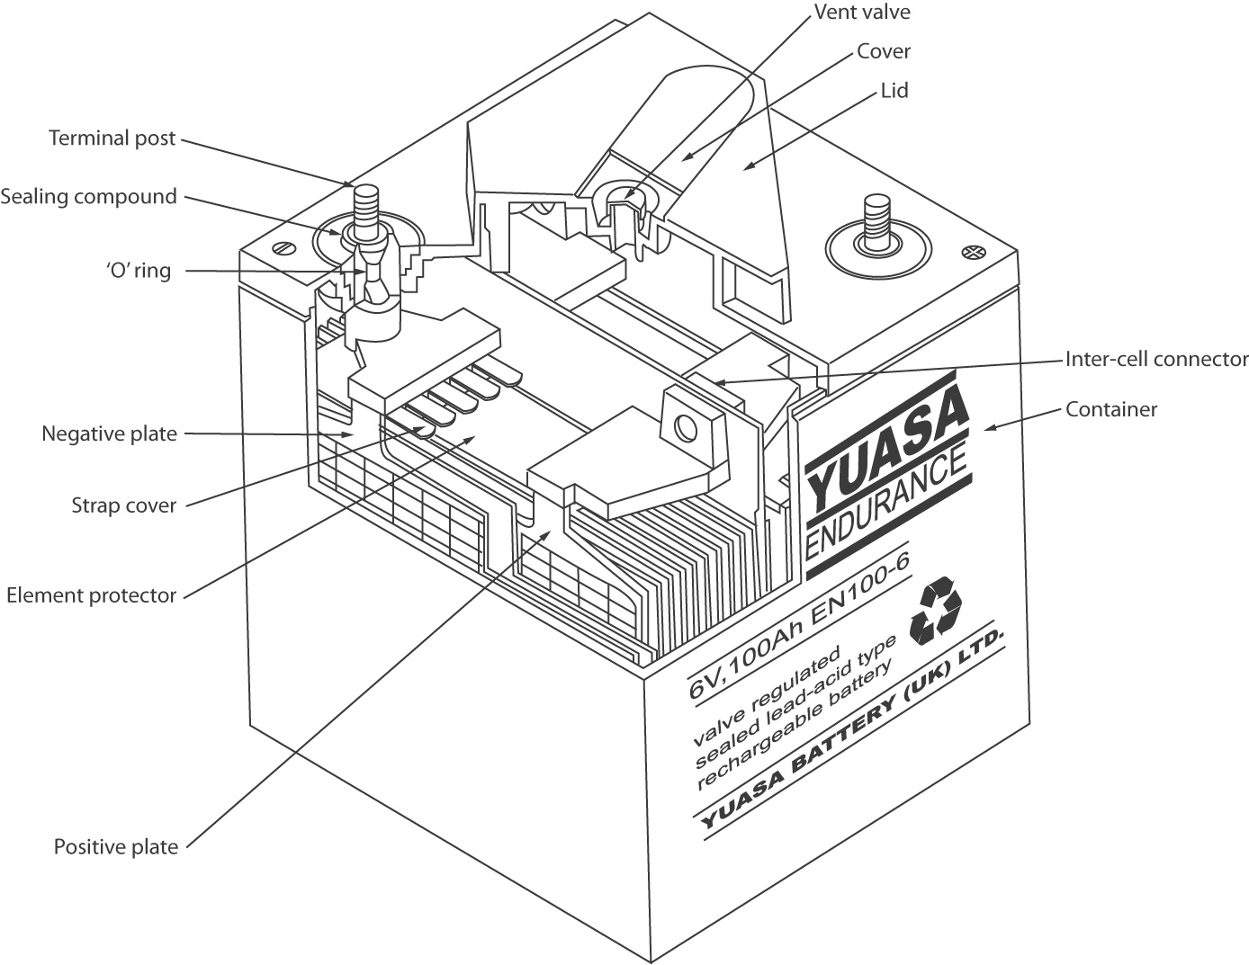
Structure

Slide 13
Open Vented(VLA)
Also known as Flooded, these batteries have plates that are flooded with electrolyte acid. They have a long design life (up to 20 years) and are typically used in large installations needing a high ampere-hour (Ah) rating.
Because they aren’t sealed, any hydrogen generated escapes directly into the environment. This means installations using VLA batteries require more powerful ventilation systems and can pose a greater safety hazard.
To overcome these risks, VLA batteries must be placed in a dedicated room with wash-down facilities in case of acid leaks. Because they are top-vented, they must also be kept upright, with the water levels manually topped up.
They can’t be used in cabinets or racks, which means they aren’t suitable for office environments or data Centre installations. VLA batteries are also more expensive than the VRLA alternative.

Slide 14
Nickel-Cadmium UPS Batteries
Nickel-Cadmium (Nicd) batteries used to be a popular option for telecoms installations, while they are still used for UPS applications in locations with very high ambient temperatures, particularly the Middle East.
The battery electrodes are made up of nickel hydroxide on the positive plate and cadmium hydroxide on the negative plate.
NiCad's offer the advantages of a 20-year design life, the ability to handle a wide ambient temperature range (-20°C to +40°C), a high cycle life and tolerance to deep discharges.
On the other hand, Nicd UPS batteries are far more expensive than the more traditional VRLA variety. And because nickel and cadmium are toxic materials, this makes the disposal and recycling processes at the end of service life prohibitively expensive.
This is particularly true in countries with strict environmental policies and regulations, such as the UK.

Slide 15
Lithium-Ion UPS Batteries
Lithium-Ion UPS Batteries:-
Lithium-Ion (Li-Ion) batteries have long been used in electronic devices such as laptops and smartphones, while they are now core elements in the growth of electric vehicles. But recently they are becoming an increasingly viable option for uninterruptible power supplies and other energy storage systems, such as harnessing the power from renewable energy technologies like wind or solar, too.
The advantages of Li-Ion include higher reliability than traditional VRLA/SLA batteries because of built-in battery monitoring and management systems, which check every individual cell for any change in performance.
Another benefit of Lithium-Ion UPS batteries is that they are significantly smaller and lighter because of their significantly higher power density. They also have faster charge times, longer cycles, and at least double the service life compared to VRLA/SLA.
Despite the cost of Li-Ion UPS batteries decreasing over recent years, it is still a far more expensive initial choice than the other options.
However, the longer service life does balance out the higher upfront capital costs. Li-Ion generates less heat and can operate at higher temperatures, meaning they don’t require as much air conditioning, which can reduce cooling costs.
Several Riello UPS products offer Li-Ion battery compatibility, including the Multi Power and Next Energy.

Slide 16
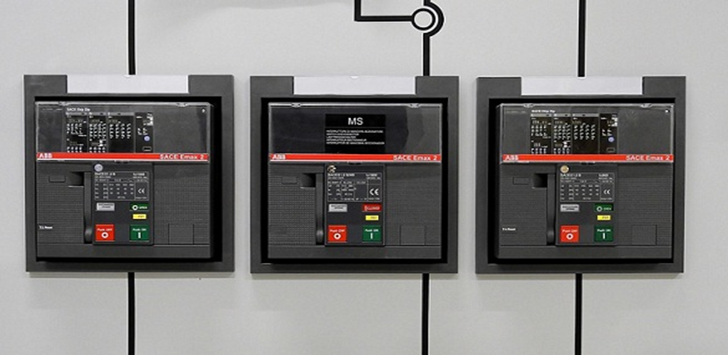
Switch gear
What is Switchgear?
Definition: A device that is used to switch, control and protect the circuits as well as devices. This is anxious about switching as well as interrupting currents under different operating conditions like normal or abnormal. In an electric power system, it is an arrangement of electrical disconnect switches, circuit breakers, fuses which are used to protect, control & separate electrical device. The switchgear diagram is shown below.

Slide 17
Switch gear
It is connected directly to the supply system by placing in the low & high voltage planes of the power transformer.
This device de-energizes for clearing the fault, testing & maintaining. These devices play an essential role in the power system to protect the equipment from the heavy current.
Otherwise, the device may get damaged & the service gets interrupted. So these devices are essential to protect the equipment from the damage like a transformer, generators, lines, etc.

Slide 18
Switchgear
Features of Switchgear
The main features of this include the following.
Manual control provision
Fast operation
Completely certain discrimination
Entire Reliability
Working
Switchgear includes switching & protecting devices like fuses, switches, relays, circuit breakers, etc. This device allows operating devices like electrical equipment, generators, distributors, transmission lines, etc.
Once the short circuit occurs within the power system, then a huge current will flow through the devices. So that the equipment can be damaged & the interruption will occur to the operators.
To overcome this problem, it is used to detect the fault in the power system. In this way, this is works to protect the equipment from the damage.

Slide 19
Components of switch-gear
It includes two components namely power conducting and control systems. The components of power conducting include fuses, switches, circuit breakers, lightning arrestors which are used for interrupting the flow of electric power.
Control systems like control panels, transformers like potential, current protective relays & connected circuitry that controls, monitors & protect the components of power conducting.

Slide 20
Functions of Switchgear
The main functions of this equipment include the following.
It protects the equipment from short-circuits & fault currents.
This device gives isolation to the circuits from power supplies.
It increases the availability of the system by allowing more than one source to feed a load.
It can open & close the electrical circuits under the conditions of normal & abnormal.
In normal conditions, it can operate manually so it ensures the safety of the operator & also proper electrical energy utilization.
In abnormal conditions, it operates mechanically. Once a fault happens this device detects the fault & detaches the damaged part in the power system. So it protects the power system from damage.

Slide 21
Switchgear types
Switchgear Types
There are three types of switch gears namely LV (Low voltage), MV (Medium voltage) and HV (High voltage) Switchgear.
Low Voltage Switchgear (LV)
The power system which deals up to 1KV is called as LV or low voltage switchgear. This kind of equipment mainly includes switches, LV circuit breakers, HRC fuses, earth leakage (EL) circuit breakers, offload electrical isolators, MCBs (miniature circuit breakers) and MCCBs (molded case circuit breakers), etc.

Slide 22
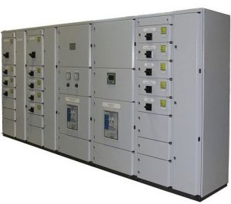
Low voltage Switchgear
case circuit breakers), etc.
The power system which deals up to 1KV is called as LV or low voltage switchgear.
This kind of equipment mainly includes switches, LV circuit breakers, HRC fuses, earth leakage (EL) circuit breakers, offload electrical isolators, MCBs (miniature circuit breakers) and MCCBs (molded case circuit breakers), etc.

Slide 23
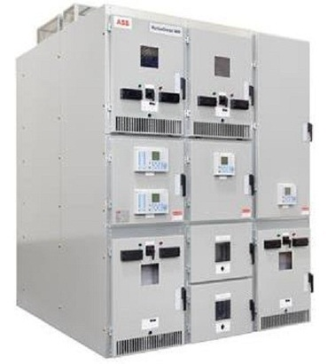
Medium Voltage Switchgear (MV)
The power system which deals up to 36 kV is called MV (medium voltage switchgear). These are available in different types like without metal enclosure outdoor type, metal-enclosed indoor & outdoor type, etc.
This kind of equipment includes substation devices like minimum oil CBs, bulk oil CBs, SF6 gas-insulated, air magnetic, gas-insulated, vacuum, etc.
The disruption medium of this type of switchgear can be vacuum, SF & oil.
The main condition of this type of power network is to break off current throughout faulty conditions in this system.
This is capable of ON/OFF operation, interruption of short circuit current, capacitive current switching, inductive current switching and used in some special applications.

Slide 24
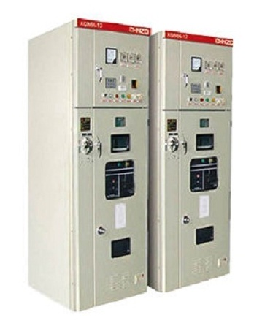
High Voltage Switchgear (HV)
The power system which deals above 36KV is called HV (high voltage) switchgear.
When the level of voltage increases then the arcing will be generated as the switching operation is extremely high. As a result, during the designing of this equipment, special care has to be taken.
The main component of this equipment is the High Voltage (HV) circuit breaker. here fore HV circuit breaker must include some safe & reliable operation features.
The switching operation of the HV circuit is very rare. Usually, these CBs remain at ON state and can be worked after some time. Consequently, these must be reliable to make certain secure operations when required.

Slide 25


